Slide 1
DIGITAL
MARKETING
COURSE

Slide 2

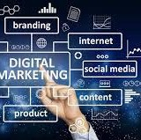

WHAT IS DIGITAL MARKETING?
The term encompasses conducted on
" Digital
all marketing
Marketing" activities
the Internet or through
electronic devices.
Promoting products and services through digital channels is one of the most popular ways to reach and engage potential customers.

Slide 3

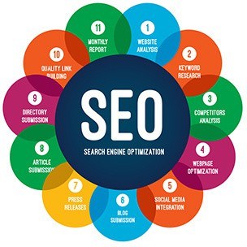


Key components and strategies of digital marketing
SEARCH ENGINE OPTIMIZATION (SEO)
The goal of SEO is to improve a website' s visibility in search engine results pages (SERPs).
1
The aim is to increase organic (non-paid) traffic via search engines.
ONLINE ADVERTISING
Online advertising includes display ads, search engine marketing (PPC or pay-per-click), social media marketing, and video marketing.
2
SOCIAL MEDIA MARKETING
Social media sites such as Facebook, Twitter, Instagram, Linked In, and others are used to
3
engage with users, share content, and build a brand presence.

Slide 4






EMAIL MARKETING
4
Email marketing involves sending targeted emails to subscribers.
AFFILIATE MARKETING
Affiliate marketing involves businesses
collaborating with affiliates (partners) who promote their products and services.
INFLUENCER MARKETING
5
6
Brands partner with influential individuals or celebrities (influencers) to promote their products or services to a larger audience
ANALYTICS AND DATA ANALYSIS
Digital marketers use data analytics tools to track and analyze website traffic, user behavior, conversion
7
rates, and other key metrics. This data helps in making informed decisions and optimizing marketing strategies.

Slide 5


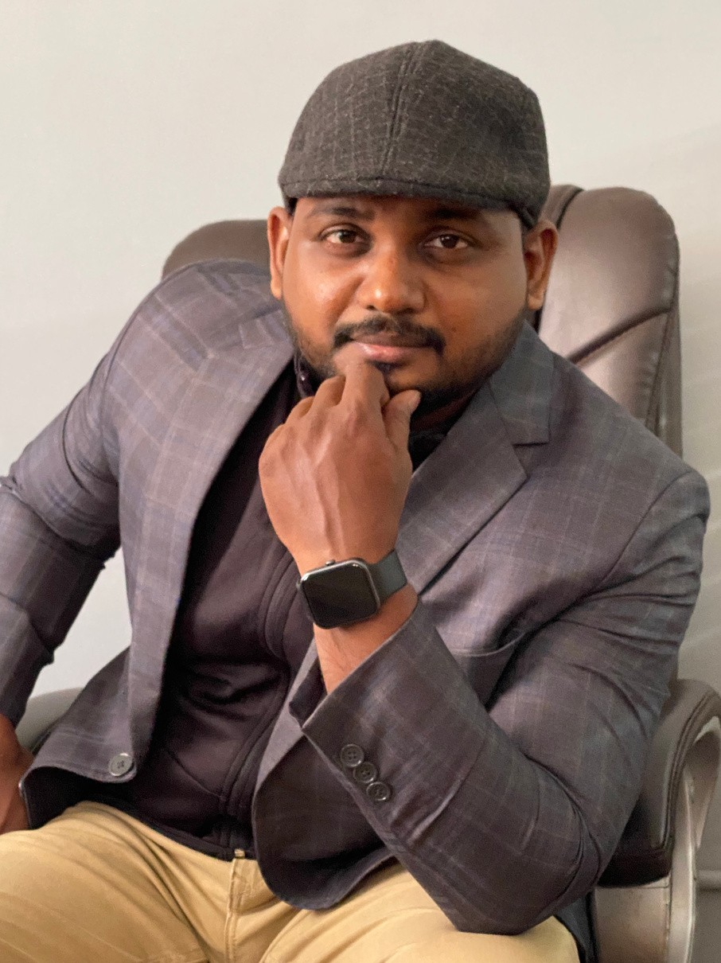
ABOUT INYMART
Inymart Institute of Digital Learning' s is a digital marketing institute dedicated to providing high-quality education and training in digital marketing. Our institute was founded by a team of experienced digital marketing professionals who are passionate about sharing their knowledge and expertise with others.
We offer a range of courses and programs in digital marketing, designed to help individuals and businesses develop the skills and knowledge they need to succeed in the digital world. Our instructors are experts in their fields and are here to provide you with Get the guidance and support you need to accomplish your goals.

Slide 6
WHAT WE ARE DOING?
Inymart Academy might offer in-person
Inymart Academy typically offer a range of courses, training programs, or workshops focused on teaching students the skills and knowledge they need to succeed in the field of digital marketing.
or online courses and may cater to
to
individuals or businesses looking
improve their digital marketing Some academies might also
skills. offer
certification programs, which can help students demonstrate their expertise to potential employers or clients.

Slide 7



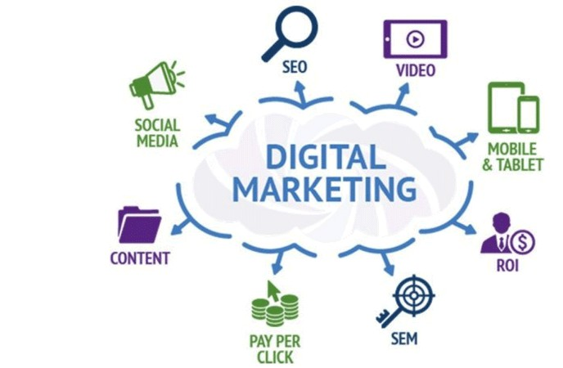
OUR TOPICS
SEARCH ENGINE OPTIMIZATION (SEO)
SOCIAL MEDIA MARKETING (SMM) EMAIL MARKETING
CONTENT MARKETING AFFILIATE MARKETING
PERFORMANCE MARKETING PPC ADVERTISING
ANALYTICS AND DATA INTERPRETATION

Slide 8
In addition to courses and training programs, Inymart
Academy resources
might such
also offer as industry
news, job events, or
boards, networking guest lectures to
help students stay up-to-date
on the connect
latest trends and with professionals in
the field.

Slide 9


Why Choose Our Digital Marketing Course?
100% PLACEMENT ASSISTANCE
EXPERT INSTRUCTORS
PRACTICAL SKILLS CERTIFICATIONS FLEXIBILITY
CASE STUDIES AND PROJECTS
UPDATED CONTENT NETWORKING OPPORTUNITIES

Slide 10


INDUSTRY-RELEVANT TOOLS
Experience the exact same tools and software used by the most successful digital marketers. With keyword research, analytics and social media scheduling tools, you'll be familiar with the tools driving digital marketing success.
PERSONALIZED GUIDANCE
We understand that every student' s learning journey is unique. Our instructors provide personalized guidance and support, ensuring you get the help you need to excel. Whether you' re a beginner or looking to enhance your skills, we' re here to help you succeed.
PROVEN TRACK RECORD
We' re proud of the success stories of our past students. Many of our graduates have gone on to secure rewarding positions in renowned companies and agencies. Join our community of successful digital marketers and be a part of our legacy.

Slide 11







CONTACT US
+91 80565 53322
inymart@gmail.com
www.inymartacademy.com
#17, C3, 3rd Floor, Ayodhya Complex, Tennur High Road,Trichy-620017, TamilNadu, India.

